Slide 1
Planar Graphs & Euler’s Formula
Exercise 8.2

Slide 2
Isomorphic Graphs
Graphs with same number of vertices + edges & the same number of connections between vertices
If vertices labelled same way, matrix representation will be the same
May look different & be labelled differently

Slide 3
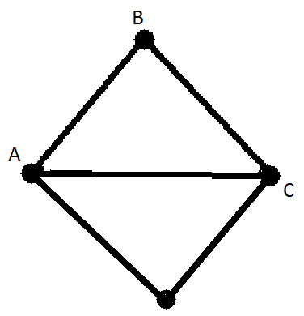
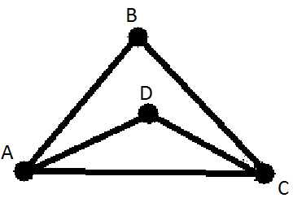
Eg. Moving D results in an isomorphic graph
Move a vertex to create an isomorphic graph (connection do not change)

Slide 4
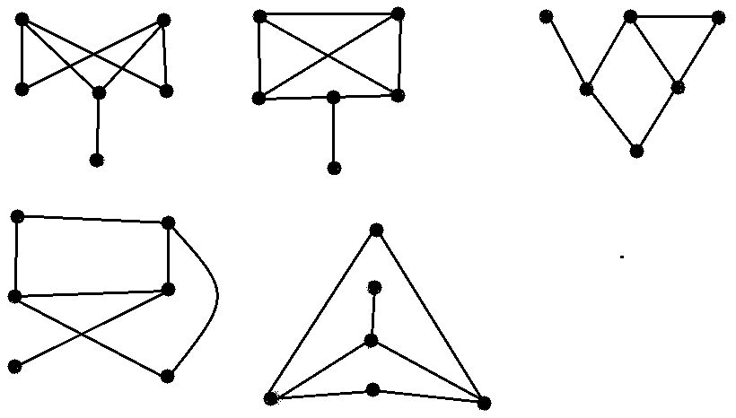
Which Graphs are Isomorphic to each other?

Slide 5
Step 1
Count Vertices & Edges
 | Vertices | Edges
A | 6 | 7
B | 6 | 8
C | 6 | 7
D | 6 | 7
E | 6 | 7
NB: B has too many edges and no match

Slide 6
Step 2:
Check the Degree of Vertex
Still cant tell, try step 3…
 | Number of Degree of Vertex
 | 1 | 2 | 3
A | 1 | 2 | 3
C | 1 | 2 | 3
D | 1 | 2 | 3
E | 1 | 2 | 3

Slide 7
Step 3:
Check Connections
Graph C has a vertex of degree 1 connected to a vertex of degree 3 (same as other graphs). Then this is connected to vertex with a degree of 3 and another with degree of 2 (other graphs are connected to vertices of degree 3)
Therefore, A, D & E are isomorphic

Slide 8
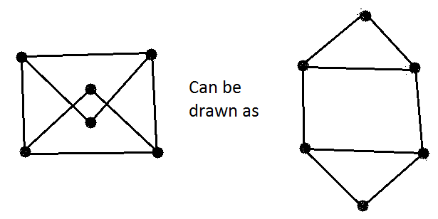
Planar Graphs
No Edges can cross at any time

Slide 9
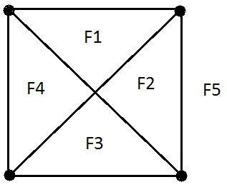
Faces or Regions
An area bound by edges (including the outer region)

Slide 10
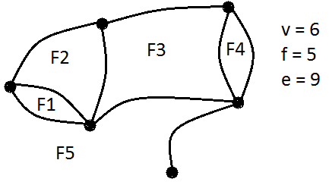
Euler’s Formula
Euler’s (pronounces Oil-er) formula is true for all planar graphs
v + f – e = 2
Where:
v = no. of vertices
f = no. of faces (regions)
e = no. of edges
v + f – e = 2
6 + 5 – 9 = 2 $∴Euler^{′}s Formula is true$

Slide 11
Eulerian & Hamiltonian Paths & Circuits
Exercise 8.3

Slide 12
Paths and Circuits
Paths
A route from one vertex to another vertex along edges in the graph
Circuits/cycle/closed path
A path that starts and finishes on the same vertex

Slide 13
Eulerian Paths
Eulerian Path
Uses every edge once and only once, but does not finish at the starting vertex
An Eulerian Path exists if:
The graph is connected
All vertices are of even degree except for 2
Start at a vertex of odd degree and finish at the other vertex of odd degree

Slide 14
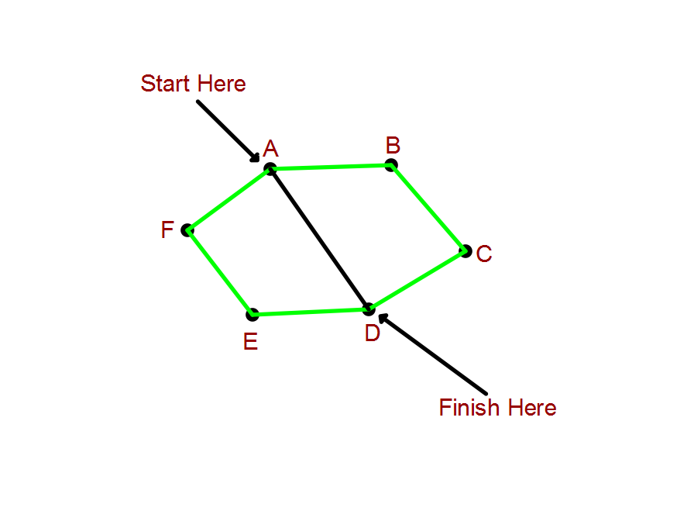
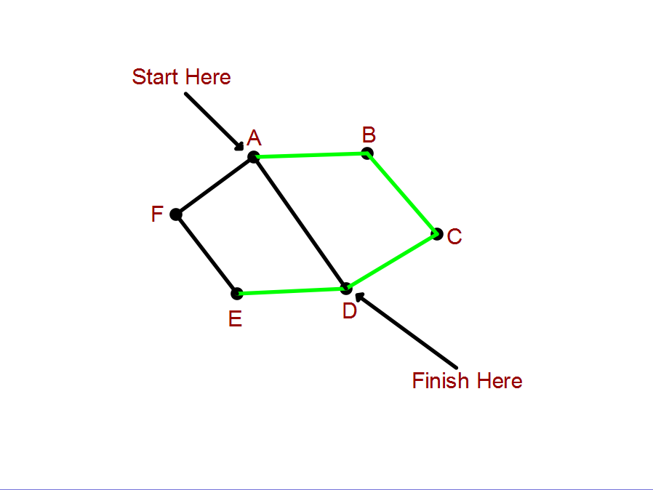
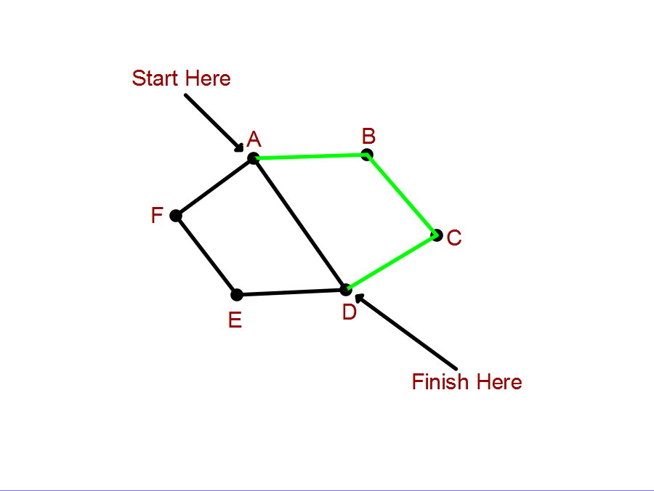
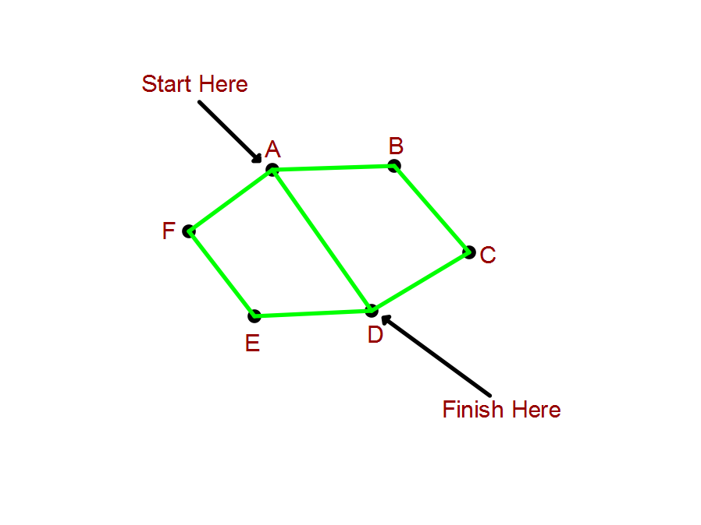
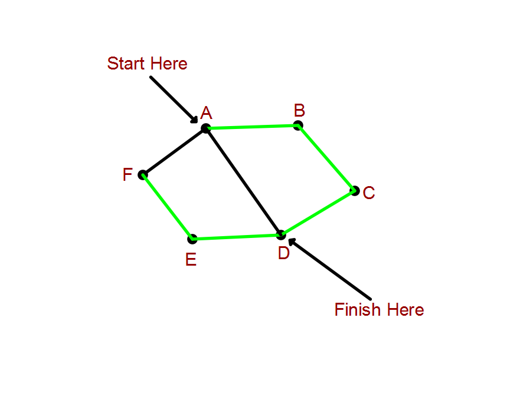
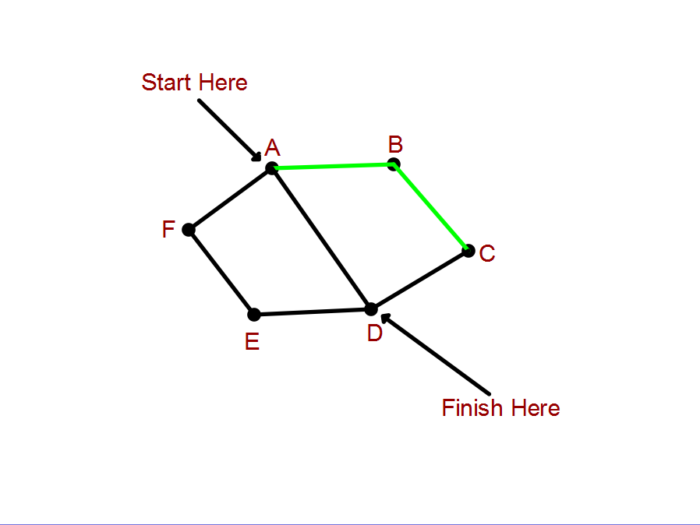
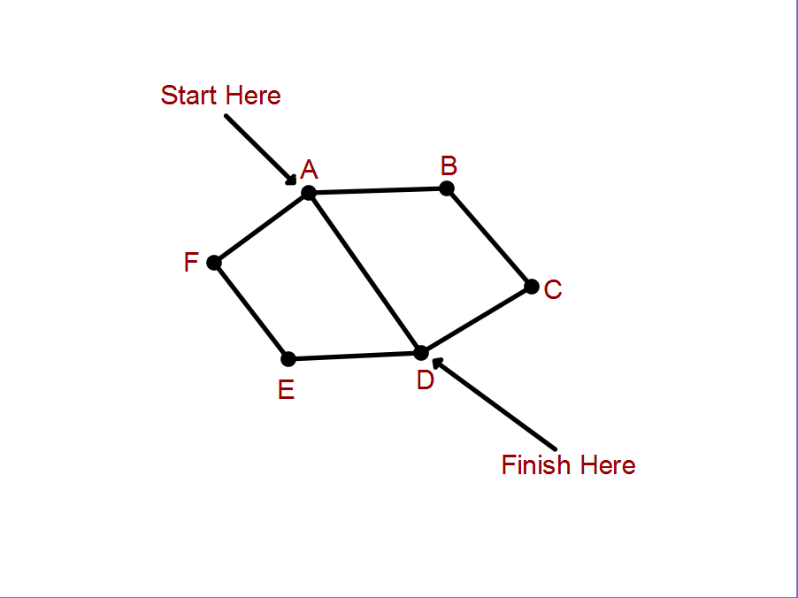
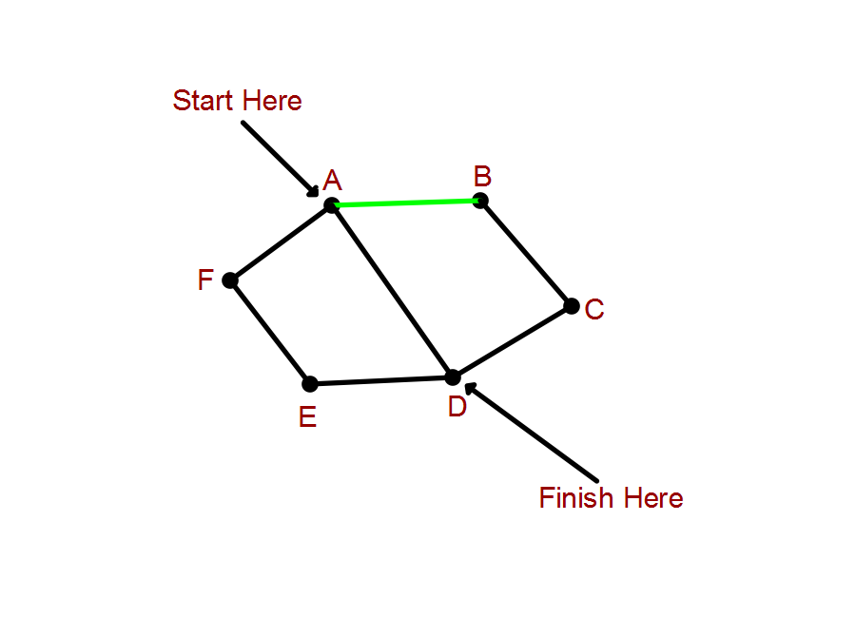
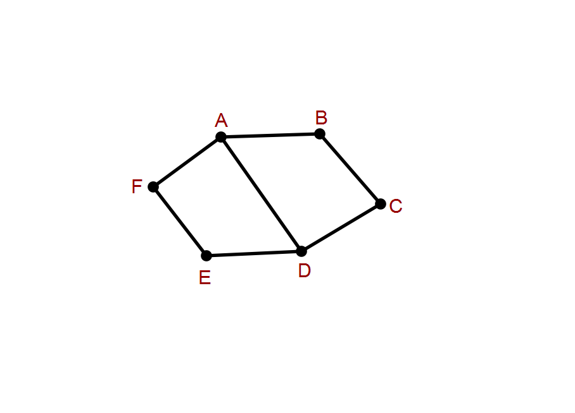
Eulerian Path = A B C D E F A D
(use vertex names to describe path)

Slide 15
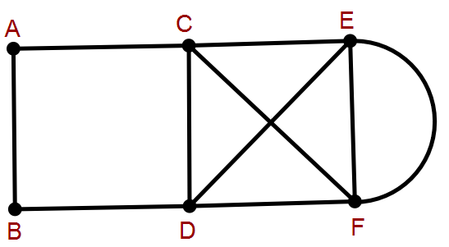
Eulerian Circuit or Cycle
Path uses every edges exactly once and returns to its starting point
If all vertices are of even degree, an Eulerian Circuit exists
Eulerian Circuit
D C A B D F E C F E D

Slide 16
Hamiltonian Paths
Passes through every vertex exactly once but DOES NOT return to its starting vertex
Hamiltonian Cycles/Circuits
Pass through every vertex and ends back at the starting vertex
N.B. Hamiltonian circuits do NOT have to use every edge

Slide 17
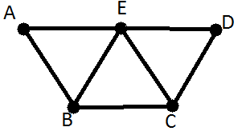
e.g. Hamiltonian Cycle
Use trial and error to find
Hamiltonian Cycle
A B C D E A

Slide 18
Weighted Graphs
Numbers are allocated to each edge
Numbers (weights) may represent
Time
Distance
Frequency etc

Slide 19
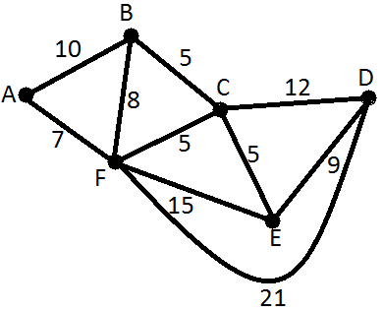
e.g. Find the shortest path between A & D
Shortest Path = A F C D

Slide 20
Find the shortest Hamiltonian Cycle
Identify various Hamiltonian cycles and calculate each weighting
Shortest Hamiltonian Cycle
A B C D E F A
10 + 5 + 12 + 9 + 15 + 7 = 58

Slide 21
Minimum Spanning Trees
Exercise 8.4

Slide 22
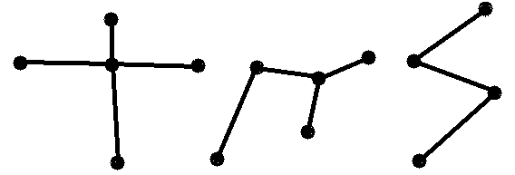
Trees
A connected graph with no cycles
Contains the minimum number of edges to make it connected
Trees have (n-1) edges, where n = no. of vertices

Slide 23
Is it a tree?
A graph has 5 vertices of degree 3, 2 vertices of degree 2 & 9 vertices of degree 1. Is it a tree?
No. of edges = $\frac{Sum of vertex degrees}{2}$
No. of vertices = 5 + 2 + 9 = 16
Sum of vertex degrees = (5x3) + (2x2) + (9x1) = 15 + 4 + 9 = 28
No. of edges = 28/2 = 14
Check if No. of edges = No. of vertices – 1 = 16 – 1 =15 ➔ 15 $≠14 ∴Not A Tree!$

Slide 24
Spanning Trees
Every graph has at least one sub graph that reaches every vertex & is a tree
To find:
Remove edges from original graph as long as the graph remains connected
OR
Start with vertices & join with edges, making sure no cycles form

Slide 25
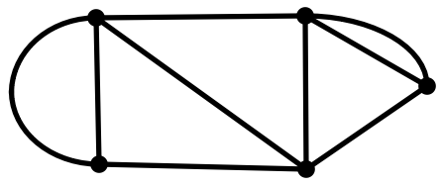
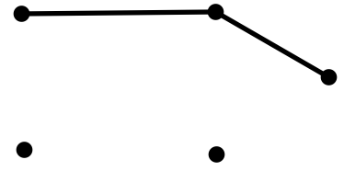
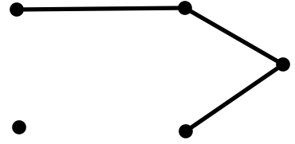
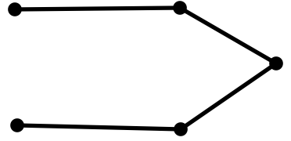
Find the spanning tree
Method 2 (adding edges)

Slide 26
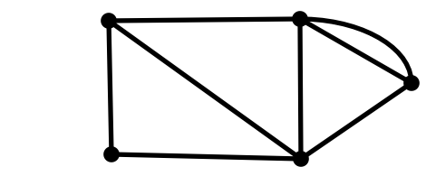
Find the spanning tree
Method 1 (take edges away)

Slide 27
Minimum Spanning Trees
Add to smallest total possible on weighted networks
Follow Pim’s Algorithm

Slide 28
Prim’s Algorithm
Step 1: Begin at any vertex
Step 2: Select edge with smallest weighting
Step 3: Look at edges coming from vertices selected so far. Select edge with lowest weighting. If cycle is created go to next smallest.
Step 4: Repeat until all vertices have been selected

Slide 29
Directed Graphs & Network Flows
Exercise 8.5

Slide 30
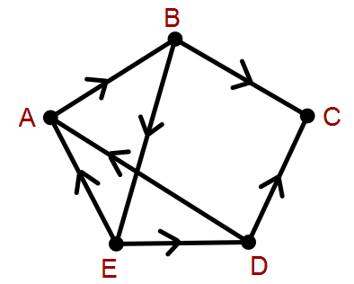
Directed Graph
Each edge has only one direction (shown by arrow)
See if all vertices are reachable
Start at a point and follow a path. If you reach a dead end, go back and try a different path
A B C ➔ Dead End
A B E D C ➔ All connected

Slide 31
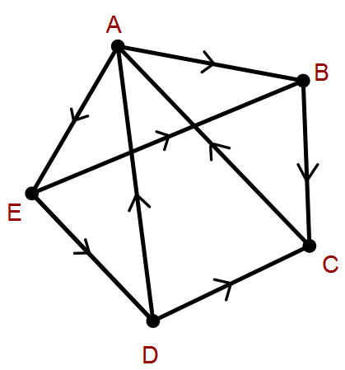
Matrix Representation (M)
Rows represent starting vertices for the edges (From)
Columns show the vertices at which the edge ends (To)
M =
To
$$\begin{matrix} & \begin{aligned}A \\ \end{aligned} & \begin{aligned}B \\ \end{aligned} \\ A & 0 & 1 \\ \begin{aligned}B \\ C \\ D \\ E\end{aligned} & \begin{aligned}0 \\ 1 \\ 1 \\ 0\end{aligned} & \begin{aligned}0 \\ 0 \\ 0 \\ 1\end{aligned}\end{matrix} \begin{matrix}\begin{aligned}C \\ \end{aligned} \\ 0 \\ \begin{aligned}1 \\ 0 \\ 1 \\ 0\end{aligned}\end{matrix} \begin{matrix}\begin{aligned}D \\ \end{aligned} & \begin{aligned}E \\ \end{aligned} \\ 0 & 1 \\ \begin{aligned}0 \\ 0 \\ 0 \\ 1\end{aligned} & \begin{aligned}0 \\ 0 \\ 0 \\ 0\end{aligned}\end{matrix}$$
From

Slide 32
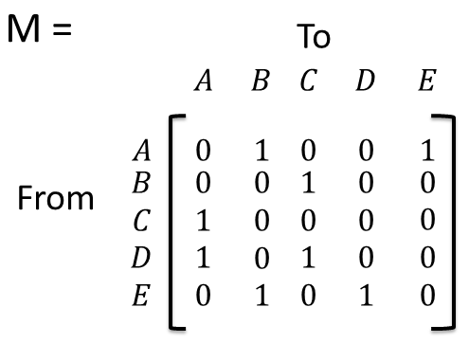
Degree of Vertex
In Degree ➔ No. of edges coming into a vertex (add column)
Out Degree ➔ No. of edges coming out of a vertex (add row)
Vertex | In Degree | Out Degree
A | 2 | 2
B | 2 | 1
C | 2 | 1
D | 1 | 2
E | 1 | 2

Slide 33
Reachability
M = number of paths possible between two vertices using one edge (a direct path)
Can use adjacency matrix to find no. of paths b/w 2 vertices using two, three etc edges
M² = no. of paths between two vertices using 2 edges
Therefore M^{n} can be used to find the paths between 2 vertices using n edges.

Slide 34
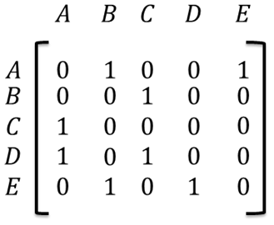
Adjacency Matrix
M² =
X
$$\begin{matrix} & \begin{aligned}A \\ \end{aligned} & \begin{aligned}B \\ \end{aligned} \\ A & 0 & 1 \\ \begin{aligned}B \\ C \\ D \\ E\end{aligned} & \begin{aligned}1 \\ 0 \\ 1 \\ 1\end{aligned} & \begin{aligned}0 \\ 1 \\ 1 \\ 0\end{aligned}\end{matrix} \begin{matrix}\begin{aligned}C \\ \end{aligned} \\ 1 \\ \begin{aligned}0 \\ 0 \\ 0 \\ 2\end{aligned}\end{matrix} \begin{matrix}\begin{aligned}D \\ \end{aligned} & \begin{aligned}E \\ \end{aligned} \\ 1 & 0 \\ \begin{aligned}0 \\ 0 \\ 0 \\ 0\end{aligned} & \begin{aligned}0 \\ 1 \\ 1 \\ 0\end{aligned}\end{matrix}$$
=
Now it shows one path possible from A to C using 2 edges where originally there was no path using only one edge.

Slide 35
Calculator

Slide 36
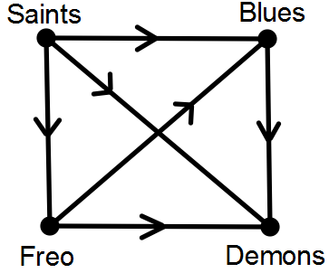
Dominance
To show when one group is dominant over another
Which teams dominate the Blues?
Saints & Freo
Which teams are dominated by the Saints?
Blues, Freo and Demones

Slide 37
Draw an adjacency matrix
M =
To
$$\begin{matrix} & \begin{aligned}S \\ \end{aligned} & \begin{aligned}B \\ \end{aligned} \\ S & 0 & 1 \\ \begin{aligned}B \\ D \\ F \\ \end{aligned} & \begin{aligned}0 \\ 0 \\ 0 \\ \end{aligned} & \begin{aligned}0 \\ 0 \\ 1 \\ \end{aligned}\end{matrix} \begin{matrix}\begin{aligned}D \\ \end{aligned} \\ 1 \\ \begin{aligned}1 \\ 0 \\ 1 \\ \end{aligned}\end{matrix} \begin{matrix}\begin{aligned}F \\ \end{aligned} & \begin{aligned} \\ \end{aligned} \\ 1 & \\ \begin{aligned}0 \\ 0 \\ 0 \\ \end{aligned} & \begin{aligned} \\ \\ \\ \end{aligned}\end{matrix}$$
From

Slide 38
Complete the Dominance Matrix
$$\begin{matrix} & \begin{aligned}A \\ \end{aligned} & \begin{aligned}B \\ \end{aligned} \\ A & & \\ \begin{aligned}B \\ C \\ D \\ \end{aligned} & \begin{aligned}1 \\ \\ 0 \\ \end{aligned} & \begin{aligned}0 \\ 0 \\ \\ \end{aligned}\end{matrix} \begin{matrix}\begin{aligned}C \\ \end{aligned} \\ 1 \\ \begin{aligned}1 \\ 0 \\ \\ \end{aligned}\end{matrix} \begin{matrix}\begin{aligned}D \\ \end{aligned} & \begin{aligned} \\ \end{aligned} \\ & \\ \begin{aligned} \\ 0 \\ \\ \end{aligned} & \begin{aligned} \\ \\ \\ \end{aligned}\end{matrix}$$
Step 1: Fill in leading diagonal with 0’s
Step 2: Remaining spaces:
Fill in opposite to reflection of leading diagonal. i.e. if there is a 0, put a 1 in the reflected space

Slide 39
2 Step Dominance
Same as reachability of one vertex to another, through two edges. Represented by matrix M²
Shows dominance over a team by being dominant of a team who has dominated this team already.
E.g. Freo dominant over the Blues who are dominant of Melbourne, therefore Freo dominant over Melbourne also.
See example in text book (pg. 419)

Slide 40
Dominance Value
Dominance value of an individual player of an individual player us found by finding:
D = M¹ + M² & then calculating the sum of each row of D.
See example in text book (pg. 419)

Slide 41
Network Flows
The weightings represent the maximum capacity of each edge.
Usually expected to find the max flow from start (source) to finish (sink)

Slide 42
Maximum Flow
Can be determined by looking for the smallest capacity of a path.
Maximum flow is 300. (Can’t force more through than the minimum allows you)

Slide 43
Cut Set
Make a cut through the network to find the maximum flow.
Cuts remove (cut off) paths from source to sink
The capacity of a cut is the sum of the edges cut

Slide 44
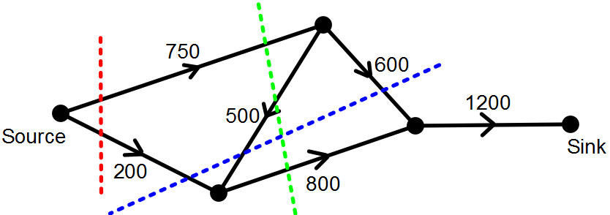
Cut Set: Find Maximum Flow
Cut 1 Capacity = 200 + 750 = 950
Cut 2 Capacity = 750 + 800 = 1550 (500 already cut off due to 750 being cut)
Cut 3 Capacity = 600 + 500 + 200 = 1300

Slide 45
Maximum Flow = Minimum Capacity Cut
For previous example is 950

Slide 46
Project Networks
Exercise 8.6

Slide 47
Project Networks
Represent Real life applications
Edges represent activities & vertices represent events.
Each event is the completion or beginning of one or more activities

Slide 48
Dependency Lists
Some activities must be completed before another can start, i.e. some edges must occur before others
Dependency lists display all prerequisite activities.
See cake Recipe in text book (pg. 429)

Slide 49
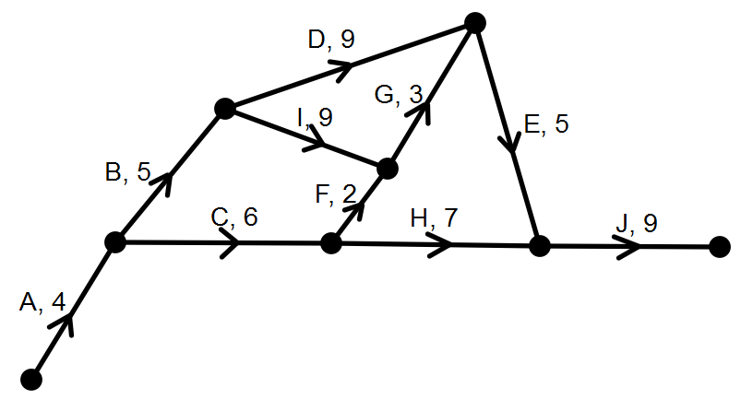
Creating a Dependency List

Slide 50
Dependency List from previous slide
Activity | Duration | Predecessor(s)
A | 4 | -
B | 5 | A
C | 6 | A
D | 9 | B
E | 5 | D, G
F | 2 | C
G | 3 | F, I
H | 7 | C
I | 9 | B
J | 9 | E, H

Slide 51
Given a Dependency List
Activity | Duration | Predecessor(s)
A | 4 | -
B | 2 | -
C | 3 | -
D | 6 | A
E | 4 | A
F | 1 | B
G | 4 | C, E, F
H | 2 | E, F
I | 5 | D, H

Slide 52
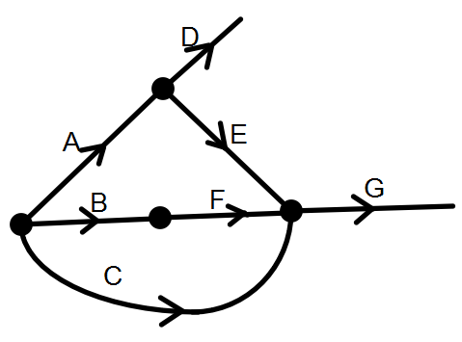
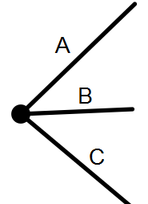
Network from Dependency List

Slide 53
But hold on, we have a problem now!
G and H both connect to E and F, but H does not connect to C
We can redraw using a “Dummy Edge” to connect E & F to G without connecting C to H

Slide 54
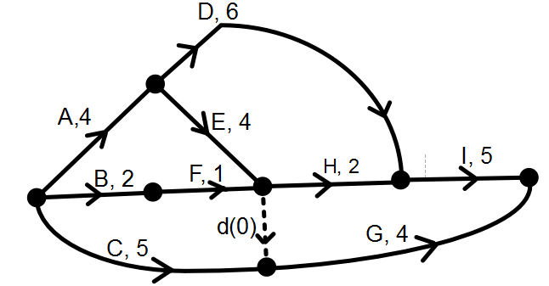
Dummy Edge (d) joins E & F with G, without joining C to H.
Join G & I so we have one finishing point

Slide 55
Critical Path Analysis
Exercise 8.7

Slide 56
Critical Path Analysis
Organising activities so that they are completed most efficiently
When weighted edges represent time, trying to find the shortest time to complete a project & organise starting times for all interrelated activities
Shortest time = path with highest weighting

Slide 57
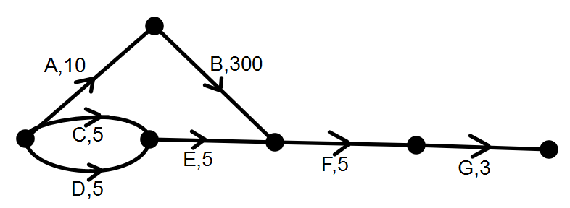
Shortest path = 18 secs
Assumption: Activity F could be performed 10 secs after starting ➔ Not Correct!
Activities B & E must both be finished before F can start
$∴$F can only be started 310 secs after start

Slide 58
Critical Paths
Paths with greatest weighting is called the critical path
Activities on it are called critical activities

Slide 59
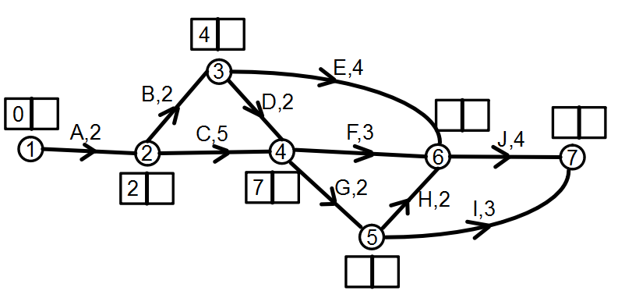
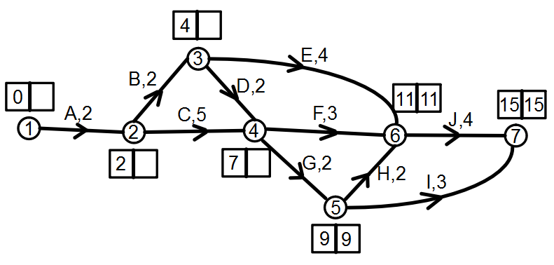
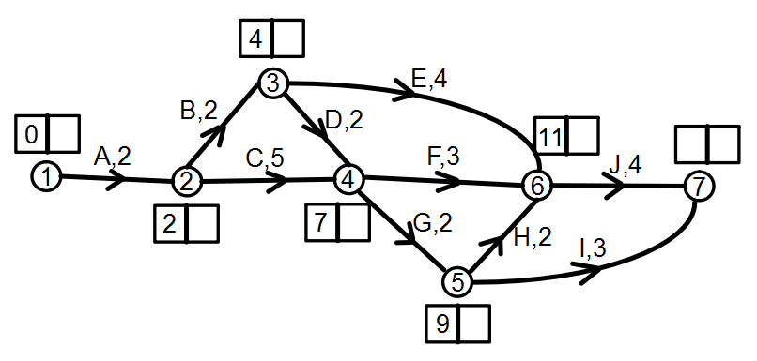
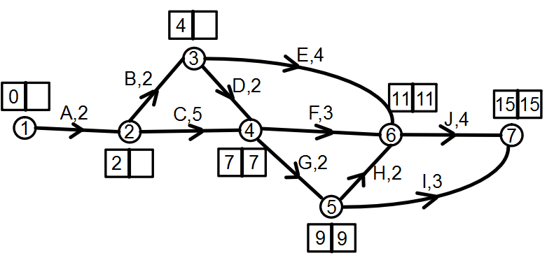
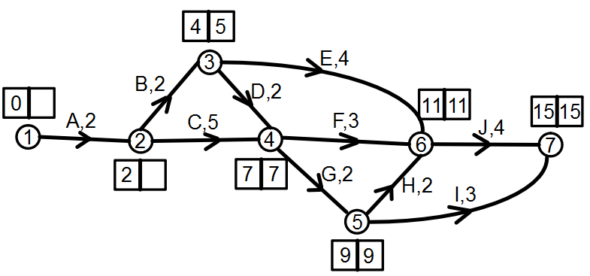
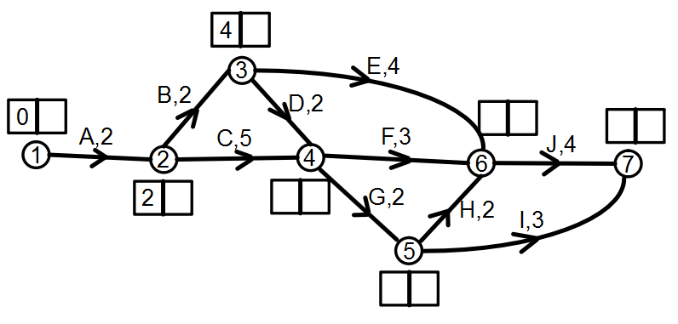
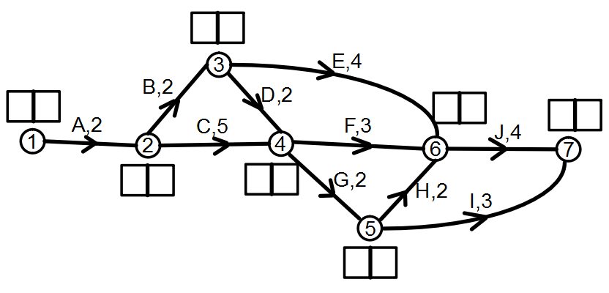
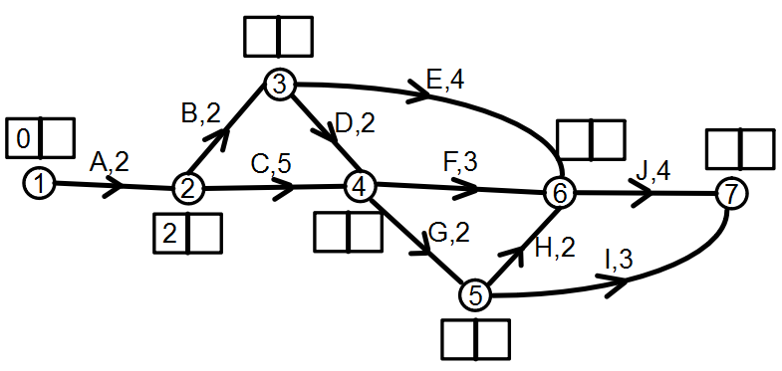
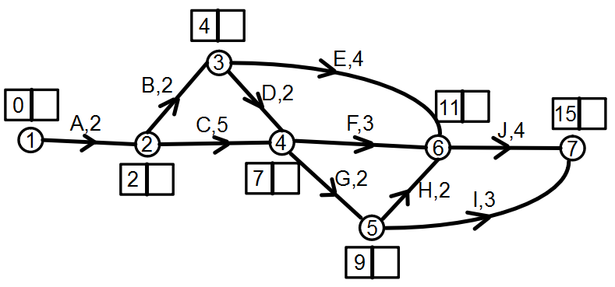
Scheduling; Forward & Backward Scanning
Trying to find the earliest time we can start each activity and the latest possible finishing time for each activity so that the finishing time is not affected.

Slide 60
Boxes
1st Box = Earliest Start Time
Work forward to find highest weighted path & hence the earliest possible starting time on next activity
2nd Box = Latest Possible Finishing Time
Work backwards to find latest possible finishing time of previous activity. If more than one edge goes to a vertex, the lower, put the lower number in

Slide 61
Float (or Slack)
Used to check critical path
Slack or Float time = latest start time – earliest start time
Latest start time = latest finish time – duration of activity

Slide 62
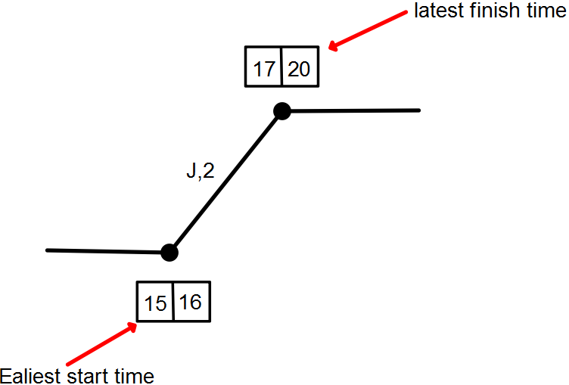
Float/Slack
Latest start time = 20 – 2 = 18
Float = 18 – 15 = 3
Therefore the activity
can start up to 3 minutes
after the earliest start
time without delaying
the completion of the
project

Slide 63
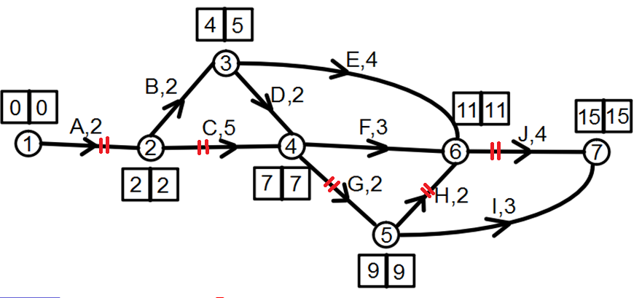
Critical Path & Float
If float = 0, then edge on critical path
(or if 1st and 2nd box the same)

Slide 64
Crashing
There may be ways to shorten the critical path
E.g. adding more workers to speed up activities.
This may cost more or less depending on bonuses & money saved by finishing early.

Slide 65
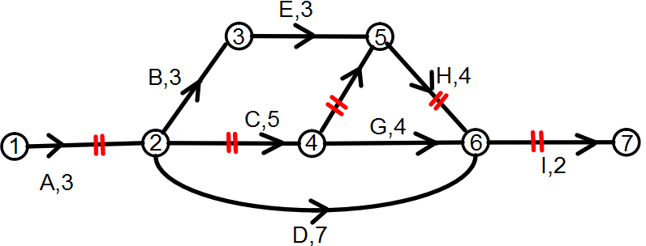
a)
Activity | Cost ($/Day) | Max Reductions (days)
C | 200 | 2
F | 500 | 2
G | 100 | 1
Shows activities that can be reduced in duration and the cost associated.
What is the shortest time the project can be completed now?
G is not on critical path ➔ no effect
Reduce C and F by two days each? Is it worth shortening by 4 days?
Reduce by 3 days as B & E take 5 days in total anyway. Reducing C & F by 4 days is means you need to wait a day and money is wasted.

Slide 66
b)
The company receives a $300 bonus for each day it finishes early. Complete the table below and describe the option that saves the most.
Project Time (days) | Total Cheapest Cost ($) | Activities Reduced In Time | Total Bonus Paid ($) | Total Savings
17 | 0 | - | 0 | 0
16 | 200 | C | 300 | 100
15
14 |  | C, F |  | 0
Reducing the project to 15 Days saves $200. This involves reducing C by 2 Days

Slide 67
Bipartite Graphs
Exercise 8.8

Slide 68
Bipartite Graphs
Involves two sets with each edge going from a vertex in one set to a vertex in the other set
No edges connect vertices in the same set
Useful for allocation tasks

Slide 69
Who shops where?
Alex likes shopping at Rebel & JB HiFi
Brooke likes shopping at Harvey Norman, JB HiFi & Big W
Crystal likes shopping at JB HiFi only
Daniel likes shopping at all four shops

Slide 70
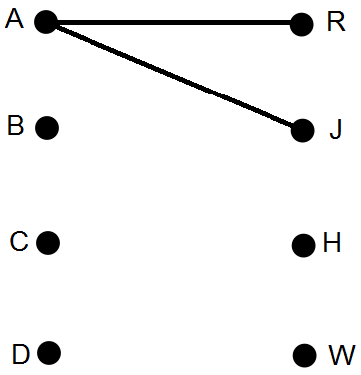
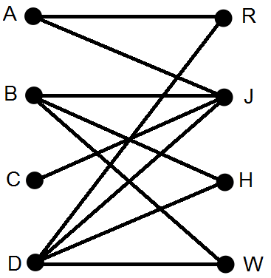
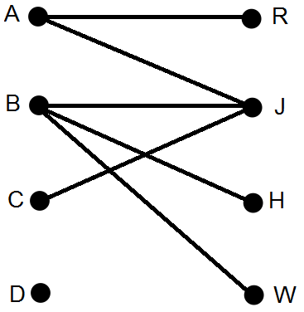
Set A (People)
Set B (Shops)
Alex
Brooke
Crystal
Daniel
Rebel
JB HiFi
Harvey Normal
Big W
Set A Set B

Slide 71
The Hungarian Algorithm
See Page 442 and 443 of text book for steps.

