Slide 1
CAEP Projects
Can’s and Can’t Do’s

Slide 2
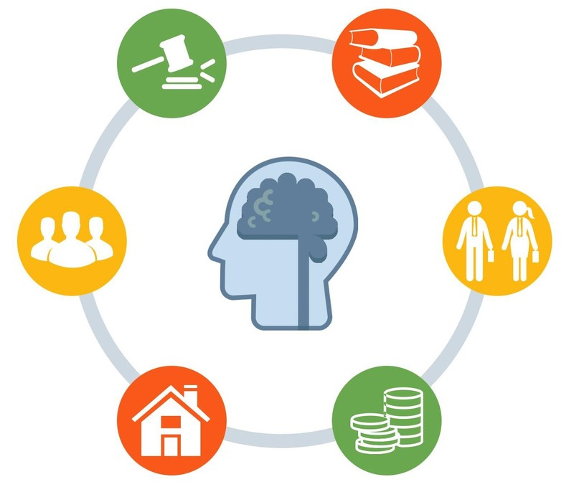
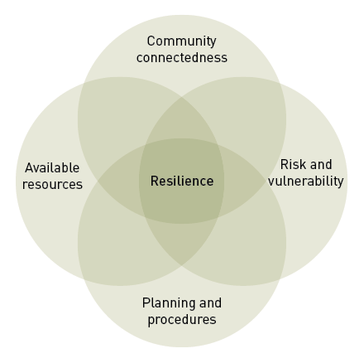
Elements which make a good community project
A clear vision
An idea that enhances links to the community
Educating your audience
Involving the community

Slide 3
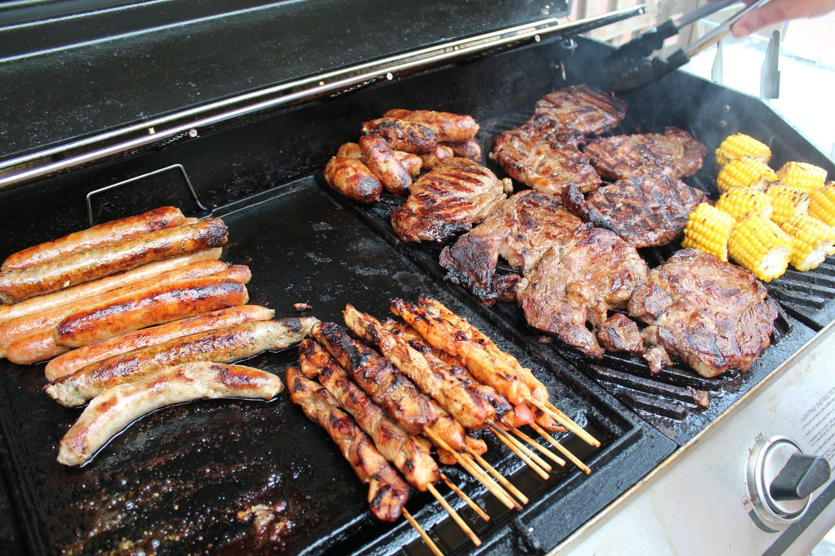
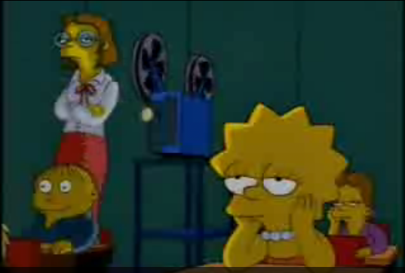
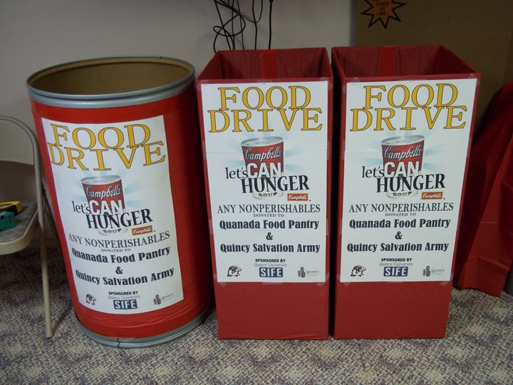
What makes a bad community project
BBQ and selling food
Movies at school
Excursion – eg taking students to a prestigious car dealerships
Collection of ‘stuff’

Slide 4
How to make your project successful
Your projects need to include many layers:
Contacting to two or more community links
Choose an appropriate audience
Choose something that you are interested in/passionate about
An element of education
Entrepreneurial – Is it exciting and new?
Written proposal and letter
Collaboration – team work
Step out of your comfort zone eg. organising an incursion

Slide 5
Art Auction - Altona Senior Citizens’ Club Exemplar CAEp Project
Through research, CAEP students recognised a need to support children in an orphanage in Indonesia. In their group students brainstormed ways in which they could offer support, looked at organisation in the community which could get involved and looked at the resources they had available to them.
With their research they identified that the ‘Altona Senior Citizens’ Club’ had an art program for elderly citizens to get involved in. They contacted the club and asked if their members would be happy to donate their pieces of art so it could be used in an auction.
Students advertise the event, sharing information of the date, location, the vision for the event and why the community should get involved. Students also created flyers sharing information of the orphanage in Indonesia which they wanted to support as well as Altona Senior Citizens’ Club.
With approval, students organised an auction at Point Cook Senior Secondary College to sell the art work donated from Altona Senior Citizens’ Club. The moneys raised was donated to the orphanage in Indonesia.
Notes:
With this information, students are to identify
The vision
Community links
Available resources

